Slide 1

Drug Review Prediction
Sonali Panigrahi

Slide 2
AI in HealthCare
AI healthcare market, valued at $11 billion in 2021, is projected to be worth $187 billion in 2030.
Applications of AI in HealthCare:
Radiology using Image Recognition
AI-assisted documentation
Robotic surgery
Fraud detection in the healthcare industry
NLP systems can convert spoken or handwritten medical notes into structured electronic health records (EHRs)

Slide 3
Agenda
Problem Statement
Data
Exploratory Data Analysis
NLP & Labels Preprocessing
Modelling
Results
Limitations and Future Works

Slide 4
Problem Statement

Slide 5
Data
Data on drug name, condition (disease), rating & patient’s review
~215k reviews: split into train (75%) and test (25%) with 708 conditions
Null Values only in conditions column (0.55%)

Slide 6
EXPLORATORY DATA ANALYSIS VISUALIZATION

Slide 7
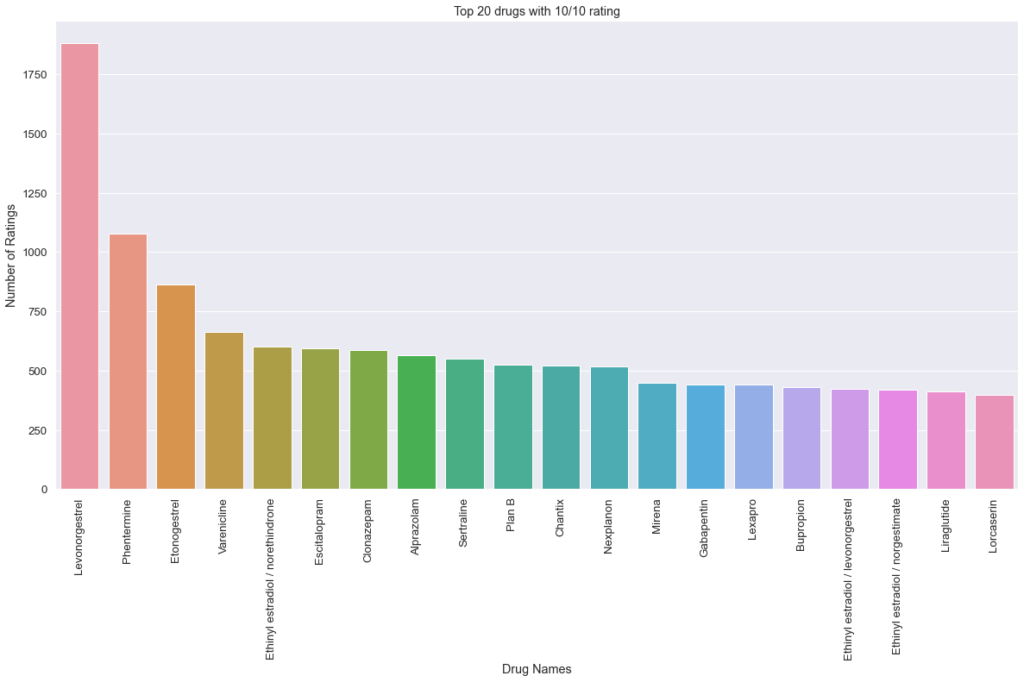
This bar plot is created using Seaborn and Matplotlib to display the top 20 drugs with a 10/10 rating, showing the number of ratings each drug has received.
T

Slide 8
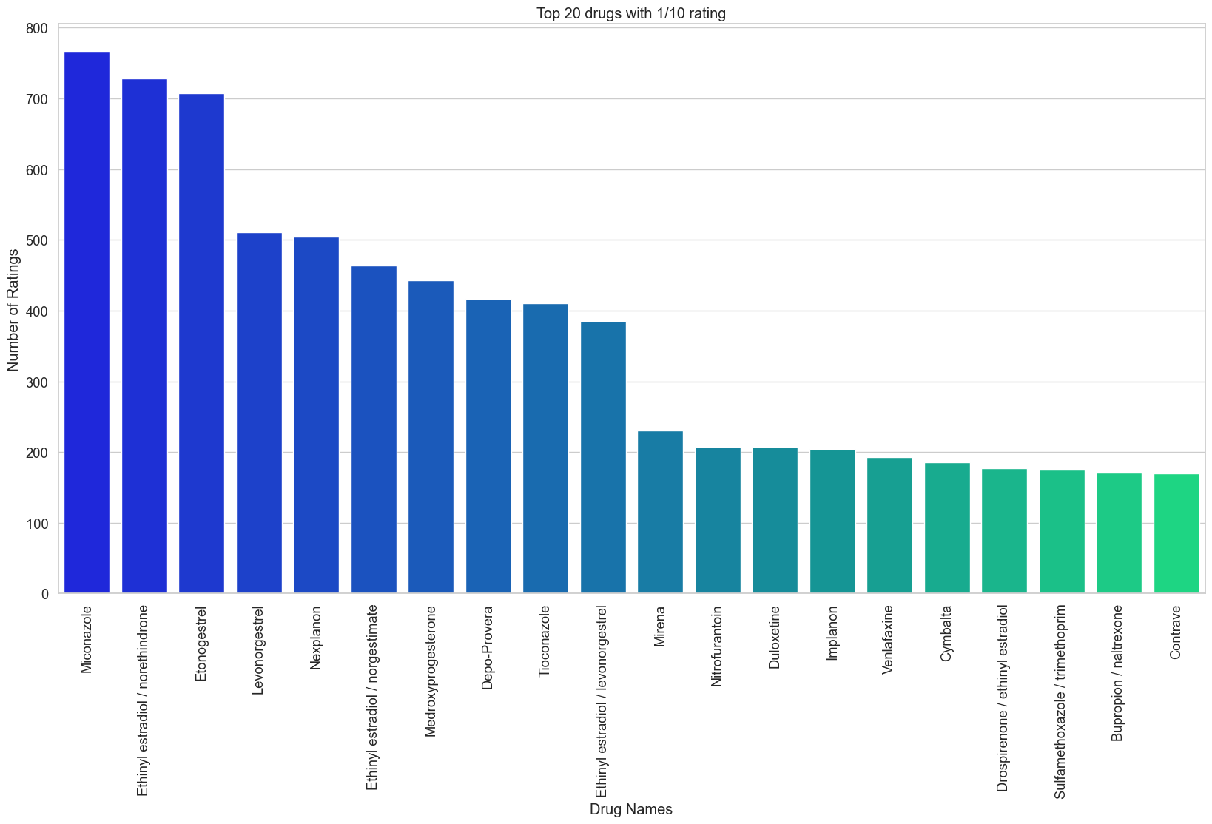
This barplot shows the top 20 drugs with the 10/10 rating

Slide 9
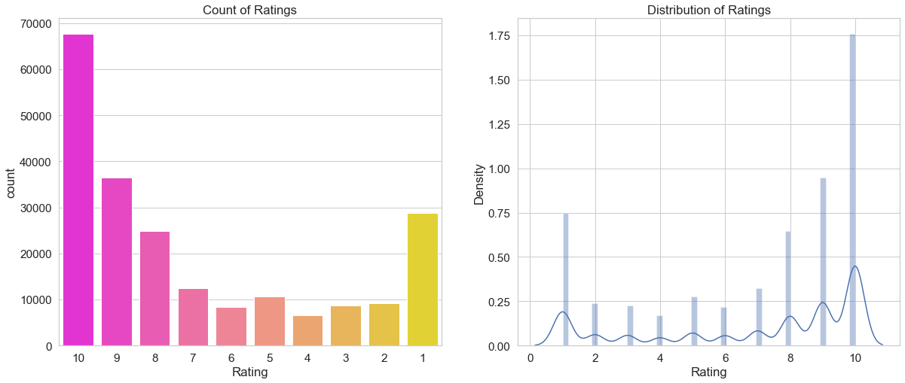
DISTRIBUTION OF THE RATING

Slide 10
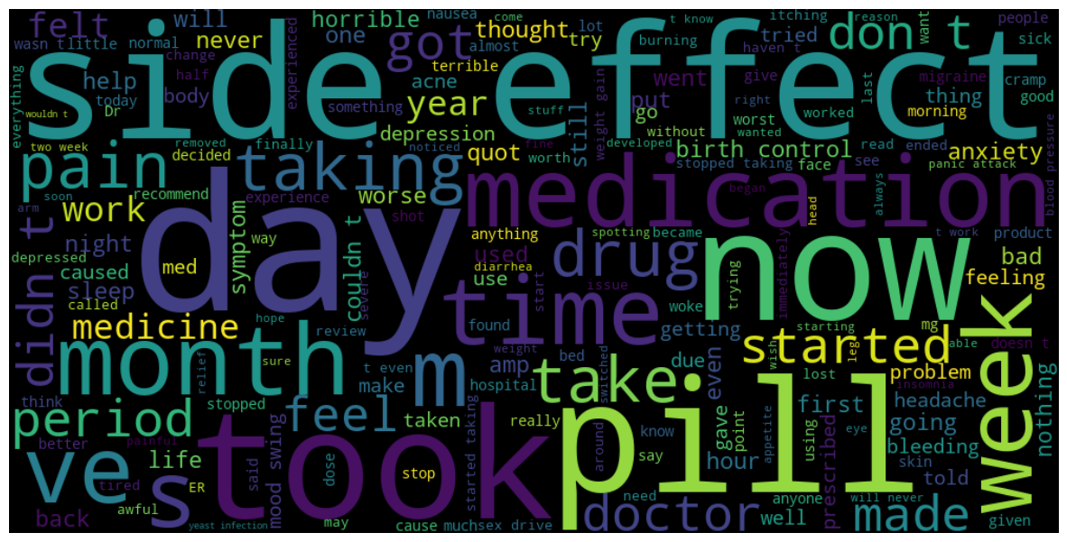
Word cloud of the reviews with rating equal to 1

Slide 11
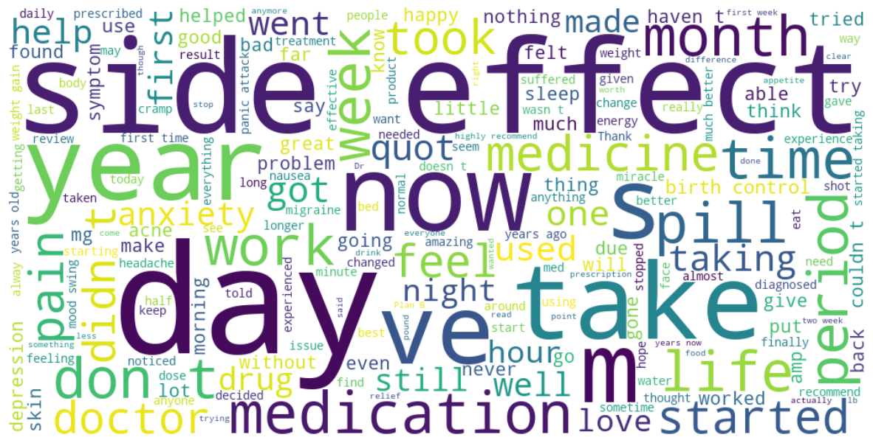
Word cloud of the reviews with rating equal to 10

Slide 12
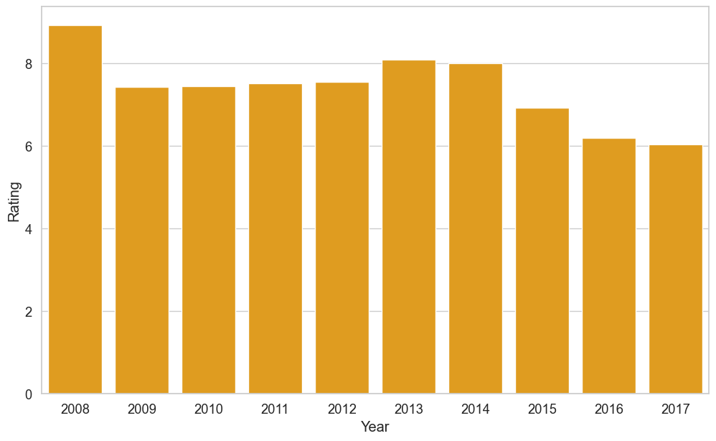
This bar plot display the mean ratings of drugs over different years. It's a good visualization to see how the average ratings have changed over time.

Slide 13
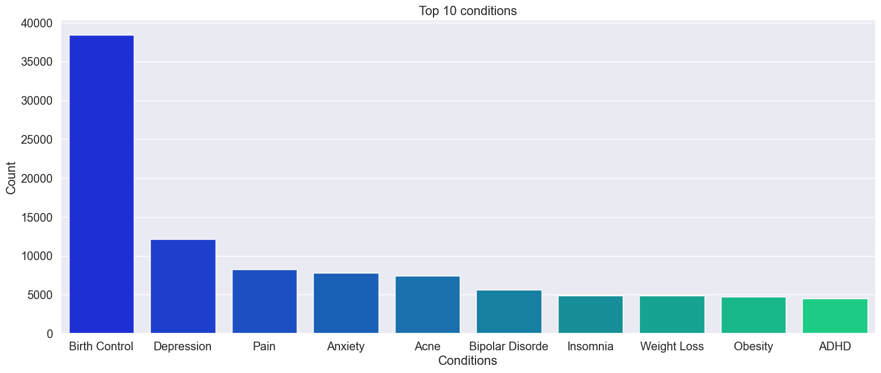
This barplot show the top 10 conditions the people are suffering.

Slide 14
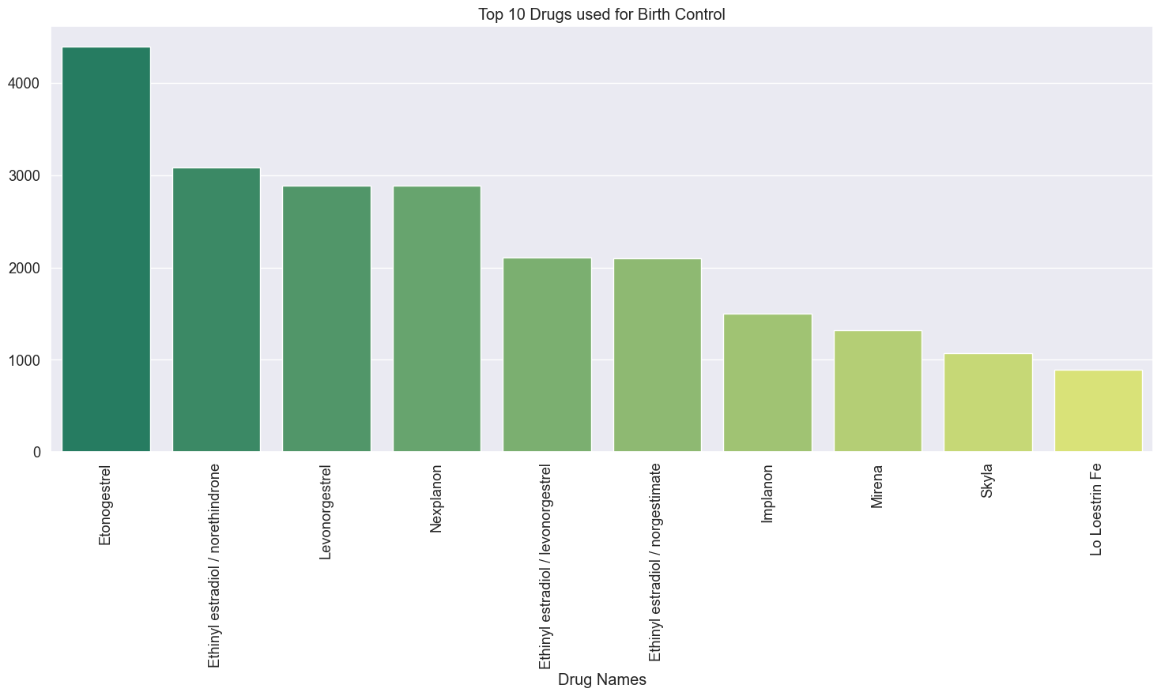
Drugs used for Birth Control

Slide 15
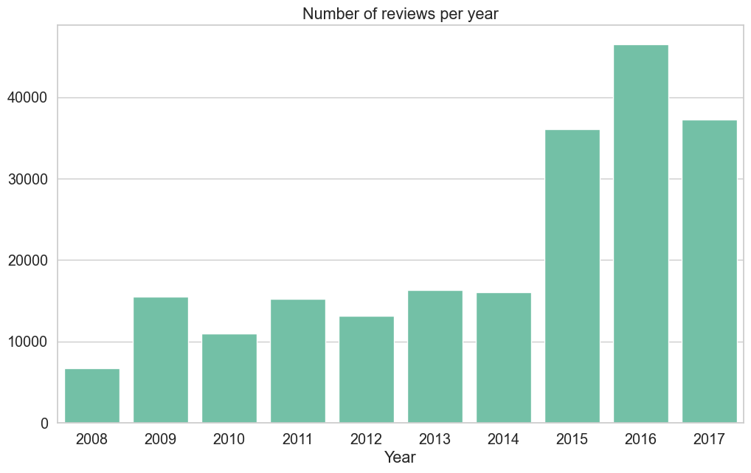

Slide 16
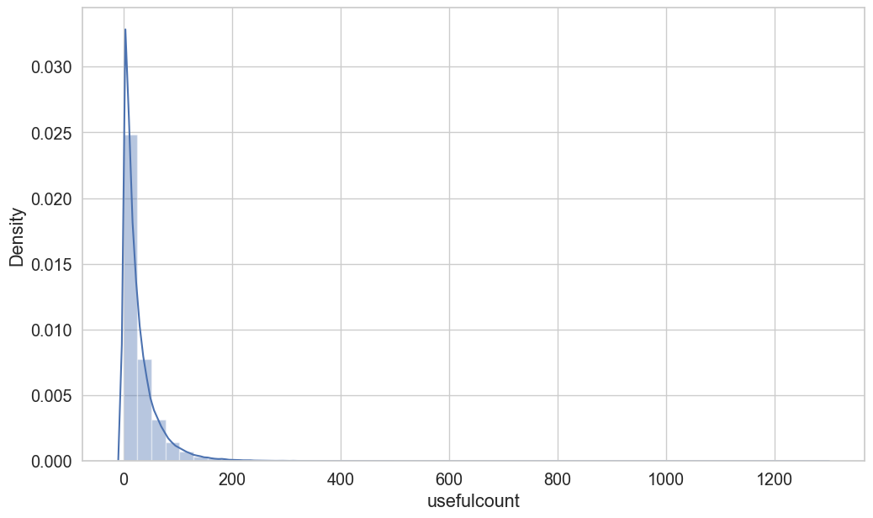
Visualization of Useful Counts

Slide 17
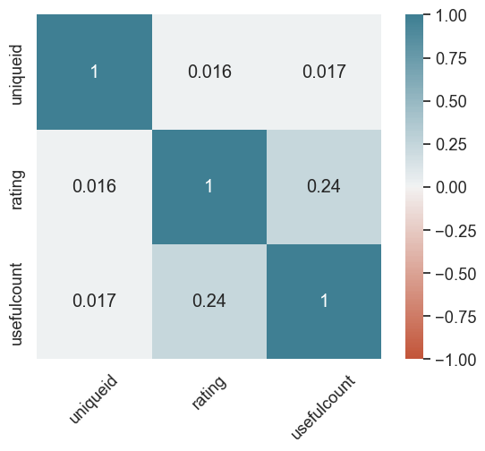
Heatmap of the Correlation Matrix

Slide 18
NLP & LABEL PREPROCESSING
LABEL PREPROCESSING
NLP (Natural Language Preprocessing)
In this model NLP is used for following reason:-
Text Data Collection and Cleaning
Tokenization
Stemming
Stopwords
For NLP tasks like classification, sentiment analysis we need to process labels.
Count Vectorization helps in preprocessing the labels.
Count vectorization converts the text data into numerical data.

Slide 19
Explanation
Tokenization:- It helps in splitting the text into individual words or tokens.
Stop Word:- It helps in removing words which does not make any sense.
Stemming:-It helps in removing the prefixes and suffixes of a word.for eg; “Beautiful”--→ “Beauty”

Slide 20
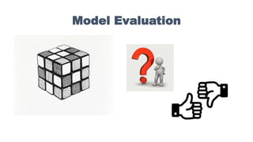

Slide 21
We have used 4 models to test the data.
1. Random Forest.
2. KNN Classifiers
3.Multinomial Naïve Bayes
4. SGD Classifiers.
After trying all the models Random forest gave the best Accuracy on the given data.

Slide 22
